Slide 1

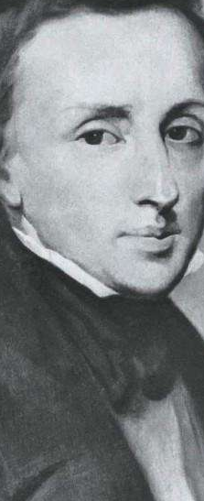
EDUCATION MODEL

